Slide 1


Automaton Theories of Human Sentence Comprehension
John T. Hale (2014)
발제자: 박기효
2020. 02. 01.

Slide 2
Chapter 4. Garden-Pathing

Slide 3
Garden-pathing
오도문/오인문
(1) The horse raced past the barn fell.
(Bever, 1970)
(2) 영희가 아이를 교차로에서 본 소녀에게 맡겼다.
(권유안, 김영진, 남기춘, 2003)
- Comprehension involves recovering a “percept” from the stream of words.
- But this percept is only a hypothesis about the word stream, one that is tokened inside the mind of the comprehender, and may turn out to be illusory.
- Garden-pathing is just the selection of the wrong structural alternative.

Slide 4
The Garden Path Theory
- The most fundamental of the garden path thory is that comprehension is single-path.
- The parser follows just one “line of reasoning”.
- The correctway to extend a given line of reasoning may be locally indeterminate.
- There may be multiple “attachment sites” available for the current word or phrase, which
is to be indeterminacy in a central part of Garden Path Theory.
- One of the famous psycholinguistic model on Garden-pathing is the two-stage model
(Frazier and Fodor, 1978)

Slide 5
The Garden Path Theory
The Two-Stage model (Frazier and Fodor, 1978)
- Syntactic processing is performed through two stages
Stage 1. Preliminary Phrase Package (PPP)
- To assign lexical and phrasal nodes to groups of words within the lexical string that is
received.
- ‘shortsighted’ device.
- Insenstive to well-formedness of incoming string.
Stage 2. Sentence Structure Supervisor (SSS)
- To combine stuructued phrases into a complete phrase marker for the sentence by
adding higher nonterminal nodes.

Slide 6
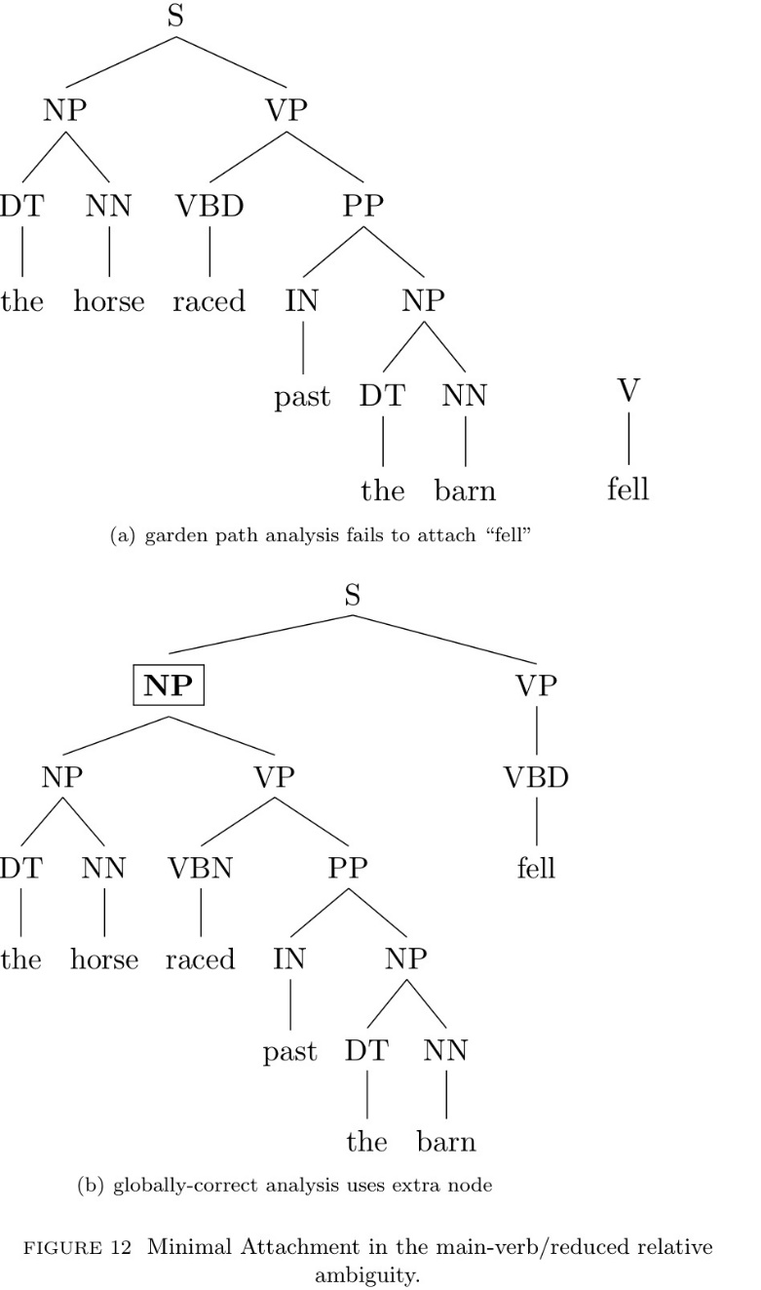
The Garden Path Theory
The Two-Stage model (Frazier and Fodor, 1978)
1. Minimal Attachment
- Do not postulate any potentially unnecessary nodes.
2. Late Closure
- If grammatically permissible, attach new items into the clause
or phrase postulated most recently.
(3) John said Mary went to the cinema yesterday.
(4) While Mary was mending a sock fell on the floor.
(4-1) While Mary was mending, a sock fell on the floor.

Slide 7
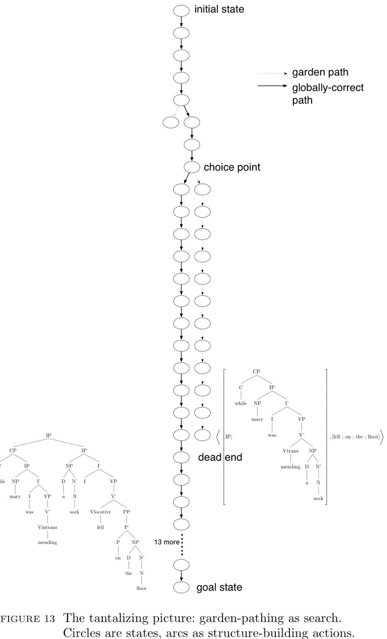
Search Space
- It presents the universe of states that accessible via any
sequence of actions, or more properly “operators”.
- It’s important to distinguish this search space from the order
in which it is actually searched by some given procedure.
- Whereas the serach tree is implicitly defined by the initial
state and the set of operators, there can be many ways of
exploring this tree, differing in the number of states the visit
and their relative ordering.
- “The parser could compute a single analysis and maintain it
until it is contradicted.” (Frazier and Clifton, 1996)

Slide 8
The Pereira-Shieber Formalization
- Fernando Pereira and Stuart Shieber (1983) formalized the Garden Path Theory within
the framework of shift-reduce parsing.
- This means that all structure-building is bottom-up.
- A recurring question facing an incremental parser of this sort is, should I close this
constituent or not?
- To close means applying a reduce action, whereas shift means going on to the next
word without closing off the current constituent.
1. Minimal Attachment
Solve all reduce-reduce conflicts in favor of the reduce move that pops the most
symbols from the stack.
2. Late Closure
Solve all shift-reduce conflicts in faor of shifting
(Pereira, 1985)

Slide 9
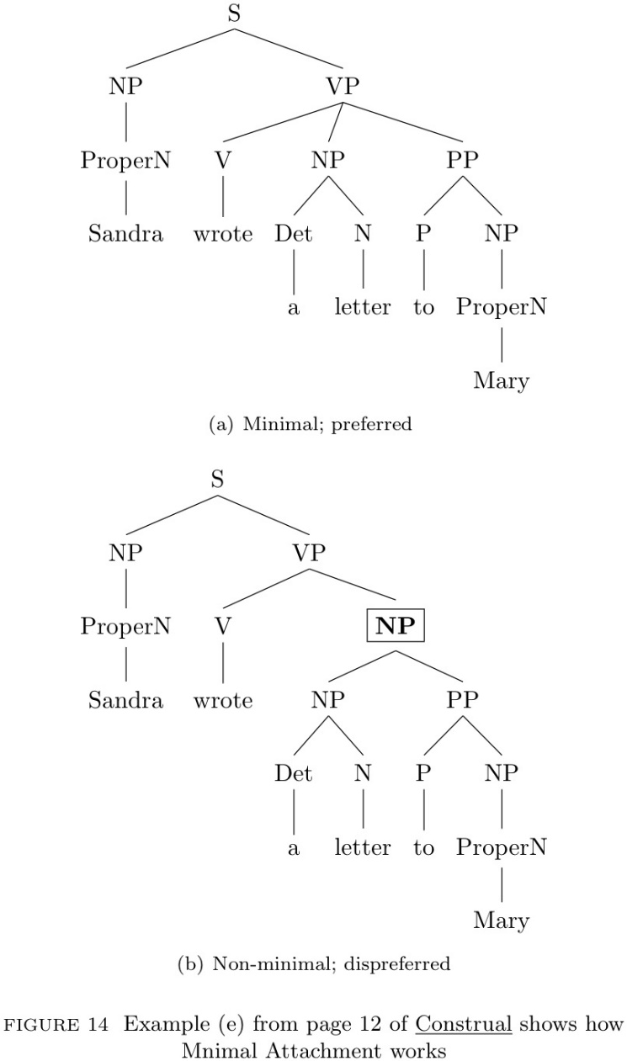
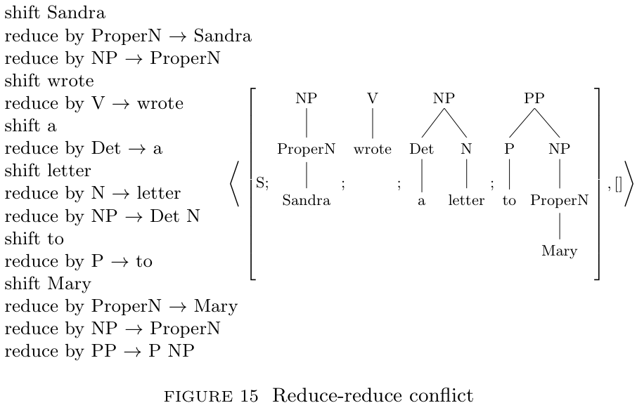
Minimal Attachment for Automata
- Fig. 14.
- Fig. 15.
- A shift-reduce parser can either reduce by the ternary rule
VP → V NP PP, or reduce bythe binary rule NP → NP PP.
- Both of these match the stack. But reducing by the longer,
ternary rule consumes more symbols from the stac and
leads the parser toward minimal analysis in 14(a).

Slide 10
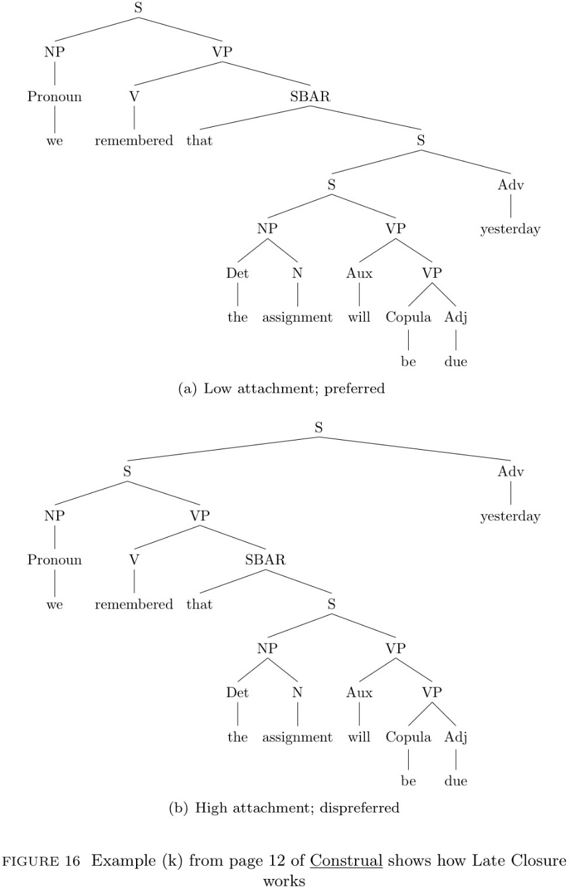
Late Closure for Automata
- Fig. 16.
- Is it time to close off the parent, SBAR, or not?
- Reducing by the rule SBAR that S bring about early closure.
- It effectively chooses a right boundary for the embedded
sentence.
- But shifting the next word, “yesterday”, leaves the SBAR open.
- Pereira and Shieber’s automaton version of Late Closure
prioritizes the latter, effectively choosing the low attachment.

Slide 11
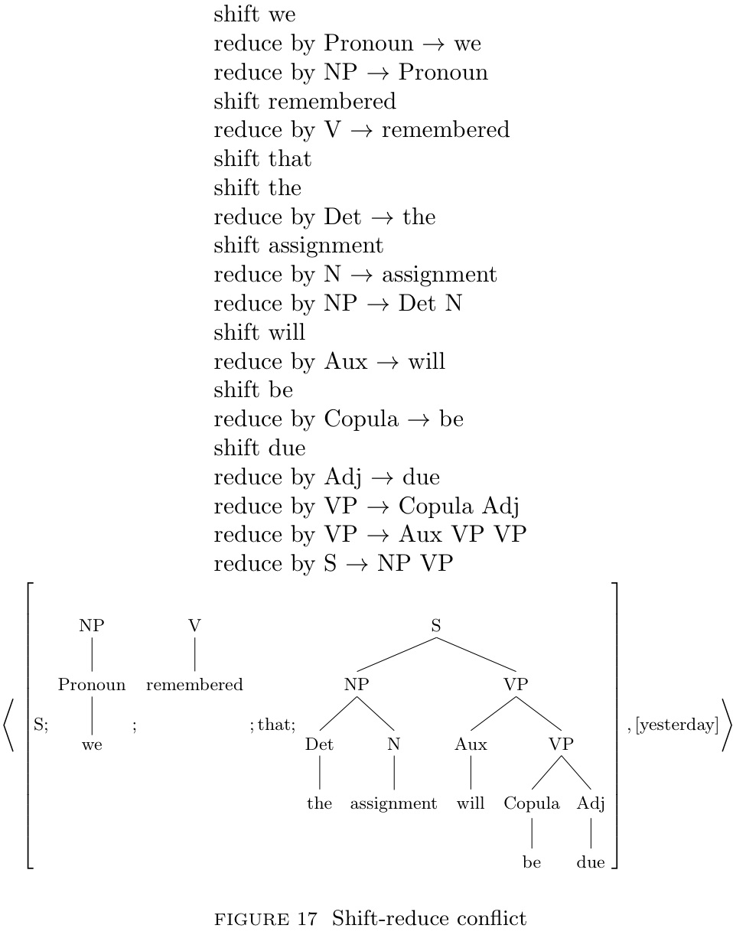
Late Closure for Automata

Slide 12
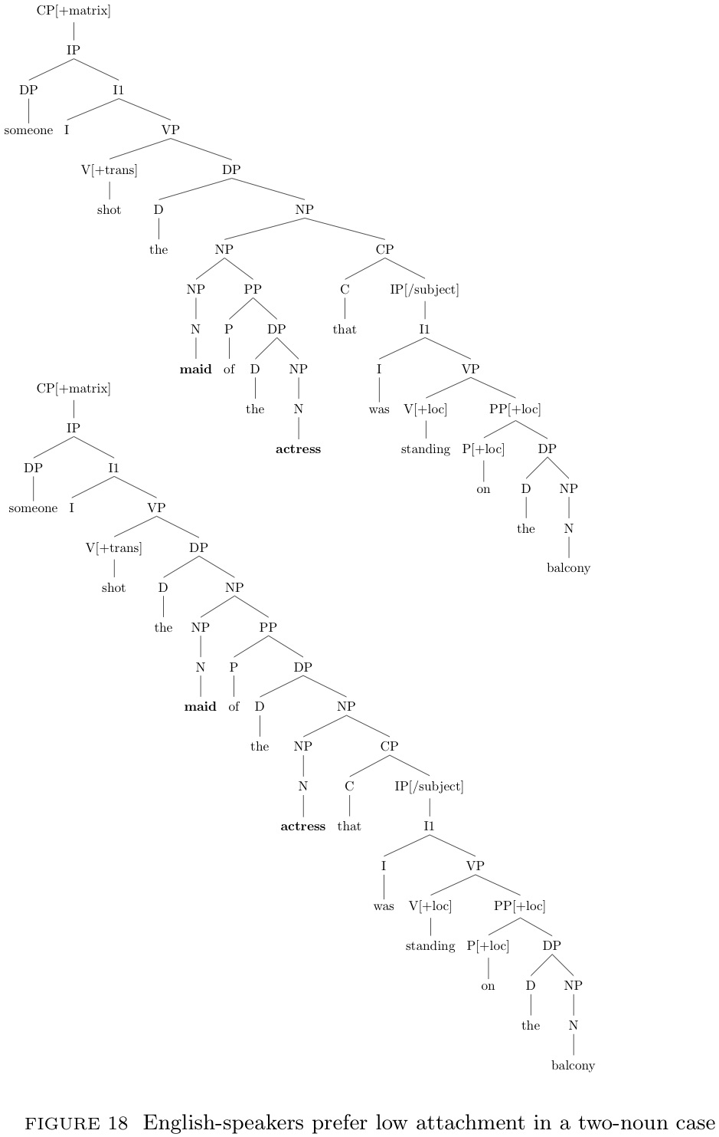
Same Heuristics, Different Grammar
- Fig. 18.
- Alguien disparó contra la criada de la actriz / que estaba en el balcón
someone shot the servant(f) of the actress / who was on the balcony
- Cuetos and Mitchell (1988) reported that Spanish participants preferred to attach [que
estaba en el balcón] to the first noun, “la criada”, rather than the second noun “actriz”.
- This finding undermined the idea of Late Closure as a language-independent, universal
asepect of the human sentence processing mechanism and pointed to an “unappealing”
alternative.

Slide 13
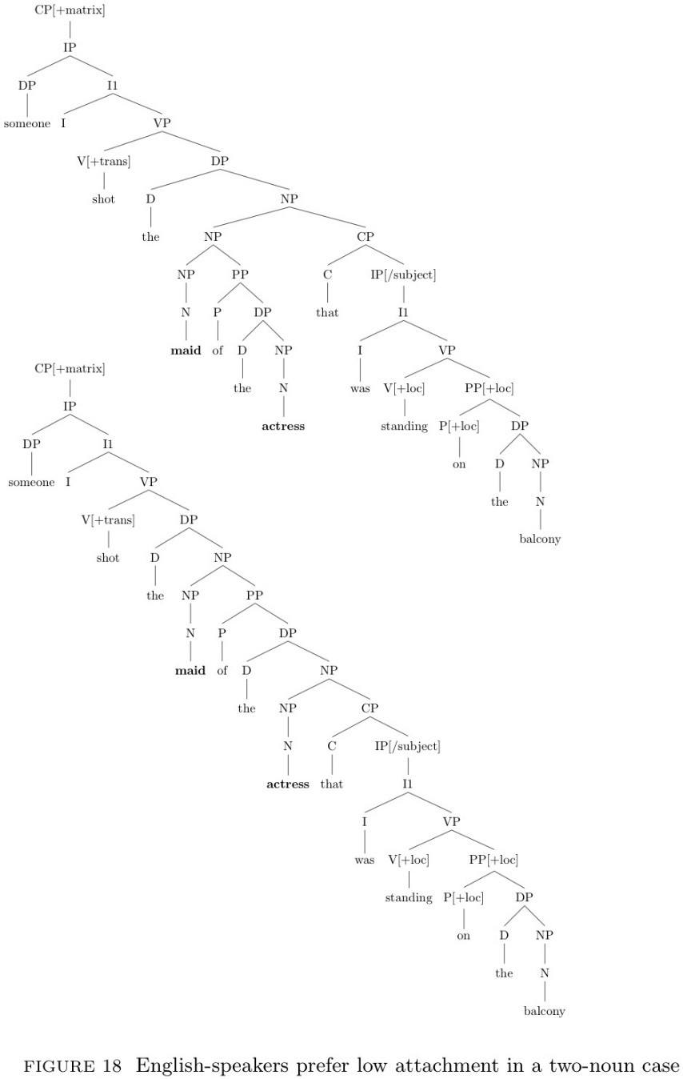
Same Heuristics, Different Grammar

Slide 14
Same Heuristics, Different Grammar
- Recently, Grillo and Costa (2014) has highlighted a grammatical point which paves the
way for a resolution, using another construction Pesudo-relatives. (Tab. 11)
- The important point is when a language offers the Pseudo-Relative costruction,
comprehenders seem to perceive it preferentially.
- Their work indicates that the relevant grammatical fact is not adjective-noun order but
rather the grammaticality of an entire construction, which fits comfortably into the
automata-theoretic framework.
- But realistically, we should expect attachment preferences to result from multiple
conflicting factors, as constraint-based lexicalists have long argued
(cf. St. John and MeCleland, 1988)
- To achieve a fully mechanistic account, we should employ basic mechanisms that can
deal with this sort of conflict.

Slide 15
감사합니다!

